Slide 1


Slide 2
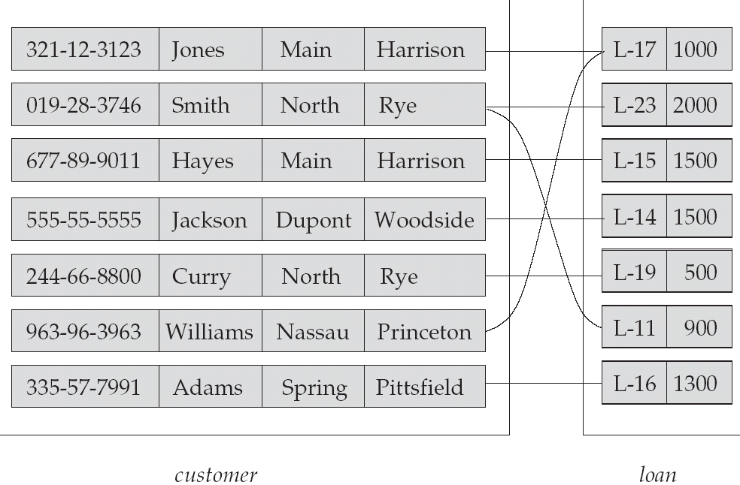
Relationship set ‘Borrower’
Relationship
Attributes
Cust_id cust_name street city
Loan no Amt
Entity
Entity Set

Slide 3
Entity :- An entity is a thing or object in the real world that is distinguishable from all other objects. Example:
Each person in an enterprise is an entity.
Entity Set :- An entity set is a set of entities of same type that share the same properties or attributes. Example:
The set of all persons who are customers at a given bank can be defined as the entity set customer.

Slide 4
Attributes :- Attributes are descriptive properties possessed by
each member of an entity set.
Each entity may have its own value for each attribute.
Example: customer_id , customer_name ,
customer_address are few possible attributes of the
entity customer.
Relationship :- It is an association among several entities.
Example: Hayes is a customer with loan no L-15.
So this relationship associates customer Hayes
with loan no L-15.
Relationship Set:- A set of relationships of same type.
Example: The relationship set borrower denotes
association between customers and the bank
loans that the customers have.

Slide 5
Relationship set ‘Borrower’
Relationship
Attributes
Cust_id cust_name street city
Loan no Amt
Entity
Entity Set

Slide 6
ENTITIES
There are two types of entities:-
Strong Entity- Entity types that have key attributes are
called strong entity.
Example : An employee(emp_id , ename, e-addr, dept_id)
Weak Entity-Entity types that do not have key attributes
of their own are called weak entities.
Example: Dependent of employees
(name, address, DOB, relationship).
Don’t have any existence without employees.

Slide 7
ATTRIBUTES
Different types of attributes are:-
Simple Attributes:- Attributes which cannot be divided into subparts.
Example- Roll No, Account no., etc.
2. Composite Attributes :- Attributes which can be divided into
sub-parts.
Example- Name, Address, etc
Name can be divided into First Name, Middle Name, Last Name.
Address can be divided into House No., Street Name, City Name,
State Name, Pin code.

Slide 8
3. Single Valued:- Attributes which have a single value for a particular entity. Example:- A person can have only one specific age.
4. Multivalued Attributes:- Attributes which have more than one value for a particular entity.
Example:- A person may have more than one phone no.
5. Derived Attributes:- The value of this type of attribute can be derived from the values of other related attributes or entities.
Example:- Age is a derived attribute and is said to be derivable from Date of Birth, which is again called a Stored Attribute.

